Slide 1



Org Structure Analytics
Responsible for
- Core Development (IT Delivery)
- Data Model changes
Analytics
Elaine Robinson
Data Science & Visualization
Pat Joyce
Data Engineering
Rafael Borghi
SAP Business Warehouse
Karen O’Sullivan
Hub
ESB Networks
Mick Finn & Team
7
4
Spoke
Customer Solutions
E&MP
Generation & Trading
ES & SIT
Valerie Lynch & Mary Walsh
Niamh Smyth & Team
Jennifer Jennings
Daragh Noctor & Team
6
4
2
3
Responsible for
Business Spoc/Analyst
Deliver certain reports as per need
Facilitate integration with Hub
Notes:
SIT - Strategy, Innovation and Transformation

Slide 2
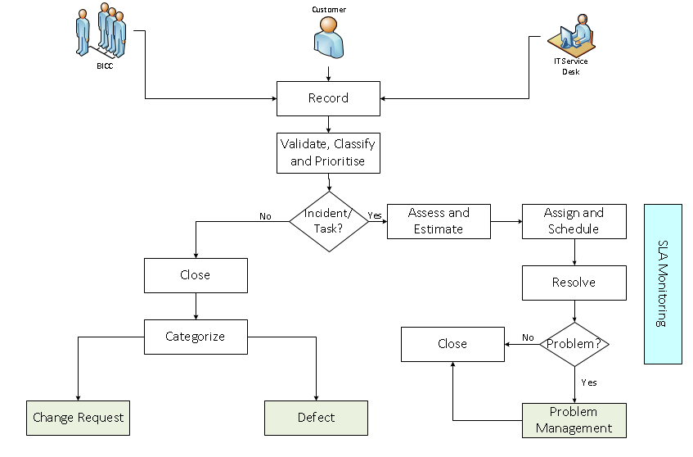
Incident/Task Management

Slide 3
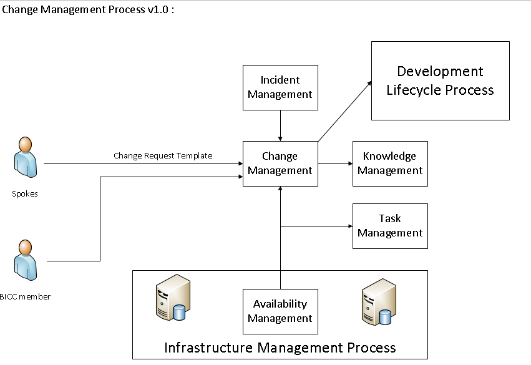
Change Management

Slide 4
Change Management

Slide 5
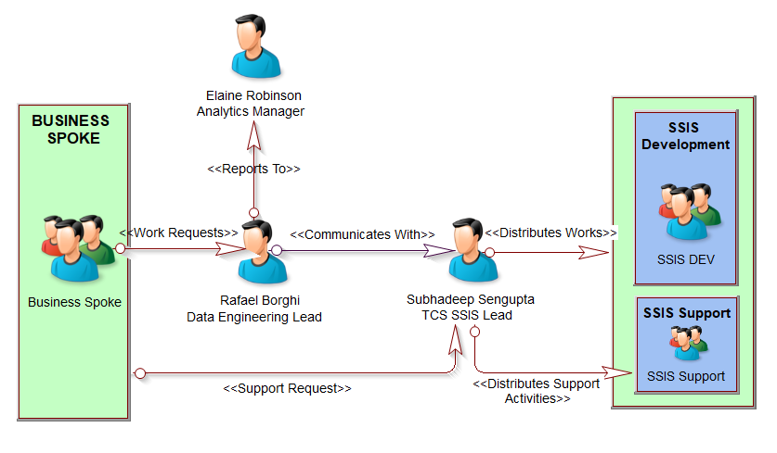
SSIS Business Communication Structure

Slide 6
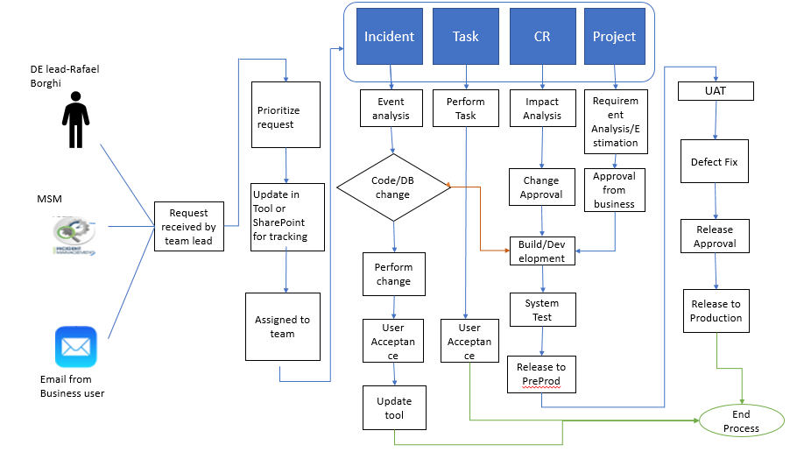
SSIS Process Flow

Slide 7










EI Data Lake(Hadoop) Process Flow
Immediate contact made to business
by Analytics Team Member
to acknowledge request
Business log a Work Request
In SharePoint
Analytics Manager/Lead reviews, logs
and assigns in Azure Dev Ops
Decision made based on
current work load and prioritisation:
Add to Current Sprint
Wait for Next Sprint
Assign to Another Person in Current Sprint
- Business Validation of Requirements
- Initial Data Exploration
- Time boxing
- Estimation of tasks
- User Story Template
created
Communicate opportunities identified
Deep-dive and validate opportunities
Extend model / analysis as needed
Review potential business recommendations
Wiki updated in MS Teams
Code logged in Repository
Documentation handover to business as needed
Automation and moving to production
- Bug fixes
- Testing

Slide 8
Customer Solutions Data Engineering & Analytics Team
Customer Solutions
Valerie Lynch
(Analytics Manager)
EI Data Engineering(Hadoop) & Analytics
( 11 Member Team)
ESB Energy Data Analytics
Mary Walsh – Analytics Lead
( 3 member team)
Name | Role
Patricia Kavanagh | Data Analyst- ESB
Sandra Dunne | Data Analyst- ESB
Anthony Quinn | Data Analyst- ESB
Prathamesh Tanawade | Data Analyst- ESB
Glen Hopkins | Data Analyst- ESB
Tom Caffrey | Data Analyst- ESB
Ang Li | Data Analyst- ESB
Stefano Campolungo | Data Analyst- ESB
Sumanth Gatti | Big Data Engineer – TCS
Magesh Gopinath | Big Data Engineer – TCS
Lisha Ghosh | Big Data Engineer - TCS
Name | Role
Mary Walsh | ESB Energy Analytics Lead - ESB
Yogesh Sanjay Golecha | ESB Energy Data Analyst - ESB
Laya Gopinath | ESB Energy Data Analyst - ESB

Slide 9
EI Data Lake Communication Structure
Business
Spoke
Elaine Robinson
Senior Manager
Analytics
Sumanth Gatti
TCS Hadoop Lead
Assigns User Stories
Reports To
Reports To
Assigns User Stories
Reports To
Rafael
Borghi
ESB Data Engineering Lead
Valerie Lynch
Customer Solutions Analytics Manager
Magesh Gopinath
TCS Senior Big Data Engineer

